Slide 1


Phishing Awareness training
Prince Damiano-CodeAlpha cybersecurity intern​

Slide 2
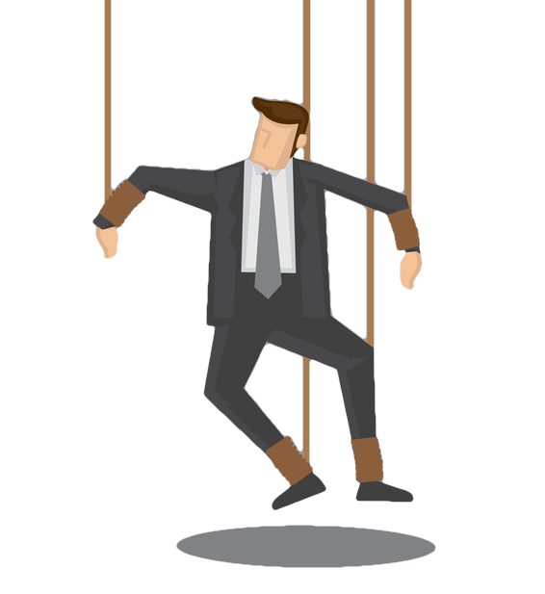
Social Engineering
Social engineering is the practice of manipulating people into taking actions that compromise security, such as revealing credentials, clicking malicious links, or sending money to attackers. It targets human psychology rather than software vulnerabilities.

Slide 3
How social engineering works
Attackers build trust or urgency through plausible stories or impersonation, then prompt a specific action (click, open, reply, transfer funds). Common channels include email, phone calls, SMS, and social media. Because it exploits human behavior—curiosity, fear, helpfulness, or authority—security teams often call it human hacking.

Slide 4


Social Engineering Tactics
Pretexting: Creating a fabricated scenario to steal information. (e.g., "I'm from IT and need your password to fix an issue.")
Baiting: Offering something enticing (a free gift card, a prize) in exchange for login details.
Impersonation: Posing as someone you know and trust—like your CEO, a colleague, or a trusted vendor—and asking for a sensitive action like transferring money or sharing data.
Phishing: manipulates people into revealing sensitive information, clicking malicious links, or installing malware by impersonating trusted parties.

Slide 5
Why is it effective
Social engineering succeeds because people naturally trust familiar brands, want to be helpful, react under perceived urgency, and often skip technical verification steps. Attackers combine technical tricks (spoofed domains, cloned emails) with psychological pressure to bypass safeguards.

Slide 6
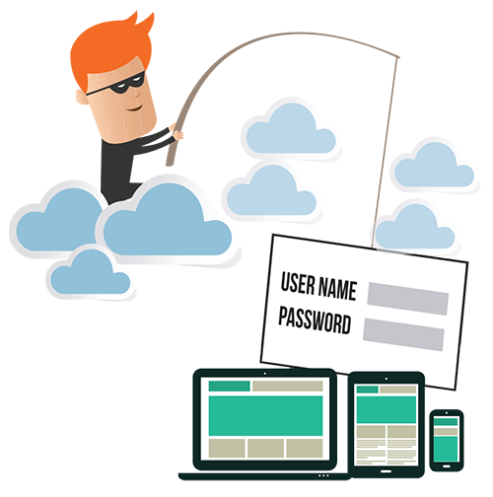
Phishing
Phishing is a social engineering tactic that manipulates people into revealing sensitive information, clicking malicious links, or installing malware by impersonating trusted parties.

Slide 7
phishing
How it works: attackers exploit trust, urgency, curiosity, or fear to prompt an action they control.
Common forms: email phishing, spear phishing (targeted), smishing (SMS), and vishing (voice).
Typical goals: credential theft, financial fraud, malware/RAT delivery, or gaining initial access for deeper attacks.

Slide 8

Email Phishing
Email phishing is a form of phishing that uses fake or misleading emails to impersonate trusted entities—like banks, tech companies, or coworkers with the goal of manipulating the recipient into performing actions that benefit the attacker, such as:
Entering login credentials on a fake website
Downloading malware disguised as attachments
Transferring money or sensitive data

Slide 9
How Email phishing works
Phishing emails often include:
Spoofed sender addresses that look legitimate (e.g., support@paypa1.com)
Urgent or threatening language: (“Your account will be suspended!”)
Generic greetings (“Dear Customer”)
Links to fake websites that mimic real ones
Unexpected attachments (.zip, .exe, .docm) that install malware
Once the victim clicks or responds, attackers can:
Steal credentials and access accounts
Deploy ransomware or spyware
Use the compromised account for further attacks

Slide 10
Real-World Example-Fake Bank Alert
From: notifications@secure-bank.com
Subject: IMPORTANT: Verify your account within 24 hours
Body : Dear Customer, We have detected suspicious activity. Verify your account now to avoid suspension: http://secure-bank.verify-account[.]com/login
Red flags: sender domain not the bank’s; link uses extra words; urgent timeout; generic greeting.

Slide 11
Real-World Example-Travel Booking Spoof
From: bookings@expedia-service.com
Subject: Your Expedia confirmation #X12345 — Invoice attached
Body :Hello customer, Please see attached invoice and itinerary. If you did not make this booking, click the link to cancel. Attachment : itinerary.zip
Red flags: unknown purchase, unexpected zip attachment.

Slide 12
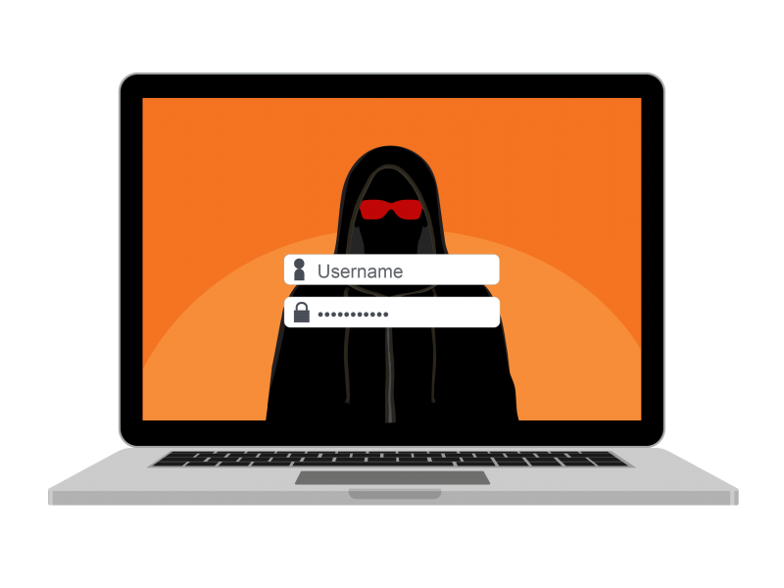
Fake Websites (Spoofed Websites)
Fake websites are sites that mimic legitimate websites ,often using similar URL, logos, and branding to gain victim’s trust with the purpose of deceiving them to into revealing sensitive information, making payments or download and install malwares.

Slide 13

Fake Websites (Spoofed Websites)
After you click a phishing link, you might be taken to a website that looks identical to a real one (e.g., your email portal, bank, or Facebook).
How to spot them: : Check the URL bar! Is the web address correct? Look for https:// and a padlock Icon. But remember even fake websites can have these. So domain name is a key!
.

Slide 14

How to Stay Safe
1
PAUSE & THINK: Don’t let urgency
Override your judgment.
2
VERIFY THE SOURCE. If in doubt, contact the sender using a known, trusted method (e.g., a phone call from a known number, not the one in the email).
3
NEVER share passwords, PINs, or MFA codes via email, text, or phone.
4
REPORT, don't reply. If you suspect a phishing email, report it to your IT/Security team immediately. Do not reply to the sender.
5
Avoid weak passwords: make sure you use
Very strong passwords

Slide 15
How to Stay Safe
6
Enable Multi-Factor Authentication (MFA/2FA) on all your accounts. This is your single most powerful defense.
7
Never use single password. Although it seems so convenient , DO NOT use single password across all your digital platforms
8
Use official software. Always use official software from official trusted vendors. Avoid cracked software. REMEMBER CHEAP IS EXPENSIVE!
9
System and software update. Always keep your system and software, including antivirus software up-to-date!

Slide 16

Test your understanding

Slide 17



What is the primary goal of social engineering attacks?
A. To exploit software vulnerabilities
B. To trick people into giving up sensitive information
C. To test network speed
D. To install malware

Slide 18
Which of the following is NOT a social engineering tactic?
A. phishing
B. Tailgating
C. SQL injection
D. Pretexting

Slide 19
Which scenario best describes pretexting?
A. An attacker sends a fake invoice
B. Attacker pretends to be from IT support
C. An attacker leaves a USB drive in a parking lot
D. An attacker follows someone into a secure building

Slide 20
How can organizations defend against social engineering attacks?
A. Installing firewalls
B. Hire a security company
C. By training employees to recognize manipulation tactics
D. Upgrading software

Slide 21
Which of the is the clearest phishing red flag in an email?
A. Professional logo
B. Email subject
C. Urgent request for credentials
D. Personalized account details

Slide 22

You hover a link and see "accounts-secure.paypal.verify-login.com" — what should you do?
A. Click it
B. Manually type “www.paypal.com”
C. Ask IT officer
D. Not sure

Slide 23
Given a screenshot of an email with sender "it-support@yourcorp.com" but reply-to "it-helpdesk@gmail.com", is this phishing?
A. Yes
B. No
C. Not sure

Slide 24
Which attachment type is highest risk from an unexpected email?
A. .pdf
B. .exe
D. .zip
C. .jpg

Slide 25
Which of the following is a common sign of a phishing email?
A. Personalized greeting using your full name
B. Email from a known contact with expected content
C. Urgent request to click a link or verify your account
D. Secure HTTPS link from a trusted domain

Slide 26
What should you do if you receive an unexpected email with a suspicious attachment?
A. Open it to see what it contains
B. Forward it to your friends for review
C. Delete it immediately without reporting
D. Report it to your IT/security team

Slide 27
Which email domain is most likely to be suspicious?
A. support@paypal.com
B. helpdesk@yourcompany.com
C. security@paypa1.com
D. usersupport@gmail.com

Slide 28
Why do phishing emails often contain spelling and grammar mistakes?
A. To test the victim’s attention to detail
B. Because attackers are careless
C. To bypass spam filters
D. To target less cautious users

Slide 29
What is the safest way to verify a suspicious email claiming to be from your bank?
A. Click the link in the email to log in
B. Reply to the email asking for confirmation
C. Call your bank using the official number
D. Ignore the email and do nothing

Slide 30
Which of the following URLs is most likely a fake website?
A. www.paypal.com
B. www.paypa1.com
C. www.Microsoft.com
D. www.google.com

Slide 31
What is a common sign of a fake website?
A. Uses HTTPS and has a padlock
B. It has a professional layout and logo
C. It asks for log in credentials on a page with spelling errors
D. It loads quickly and has no popups

Slide 32

Recap
You Are the Last Line of Defense
Hover before you click.
Report all suspicious emails.
Final Message: Cybersecurity is a shared responsibility. Your vigilance protects not just your data, but everyone's. Stay alert, stay informed, and don't take the bait!

Slide 33
Thank you
Prince Damiano
206-555-0146​
kuntarprince@gmail.com​
www.codealpha.com​

